Slide 1
Solar collector

Slide 2
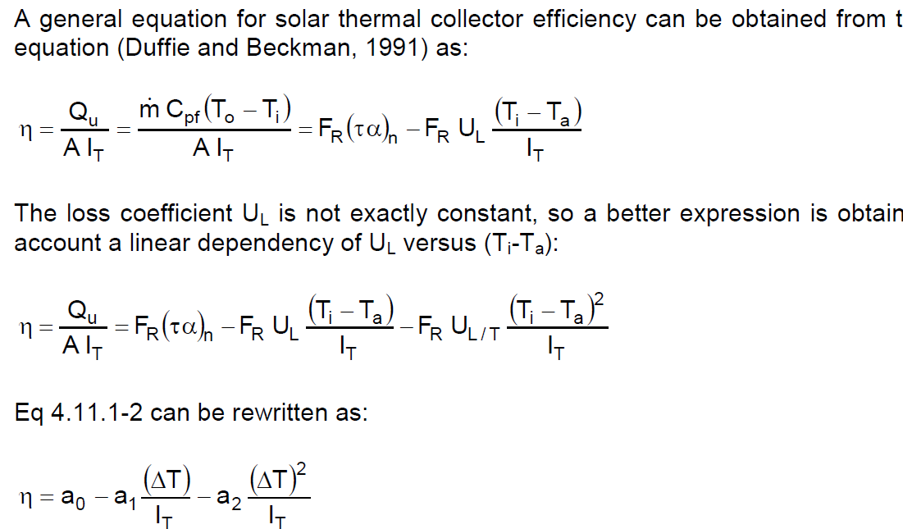
Trnsys Type1: flat plate collector (quadratic efficiency)
parameters a0,a1,a2
from collector tests (CEN,2001)
Determined for collector area = aperture area
In Europe usually determined for deltaT=Tav-Ta

Slide 3



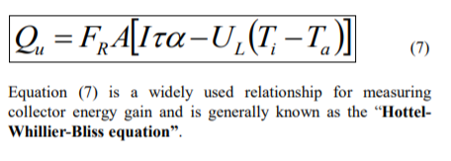
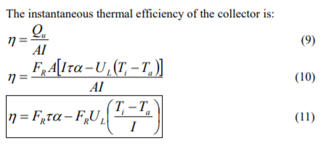
Heat Removal Factor
FR? Heat Removal Factor (cf Fabio Struckmann “Analysis of a Flat-plate Solar Collector”)
Rate of useful energy extracted by the collector (steady state):
= amount of heat carried away by collector fluid:
As it is difficult to define the collector average temp Tc in (4) =>
So, FR says which fraction of the maximum possible useful energy gain (when the whole collector is at Ti), is the actual useful energy gain (going to the collector fluid):

Slide 4
Heat Removal factor
FR=F’*F’’
with F’ is the collector fin efficiency factor (depends on geometry: diameter, distance between pipes,…)
Trnsys models with capacitance and #segments, use only F’ (derived from test data), so differential equation is with F’ instead of FR
F’’ depends on mass flow… (counts for dynamic behaviour…(?))

Slide 5
Trnsys Type1: corrections
Flow rate different from test
Collectors in series
Non normal solar incidence

Slide 6
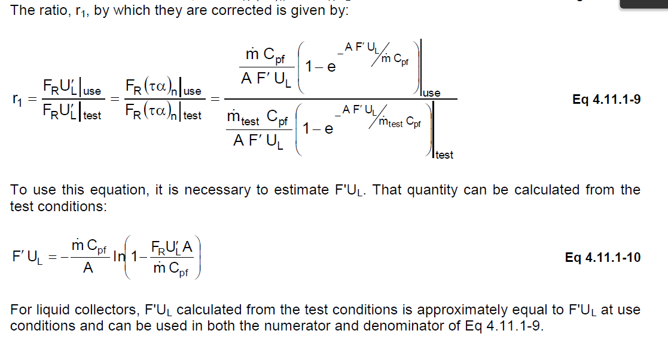
TRNSYS Type1: correction flow rate
=F’’ (in FR=F’*F’’)
This is correction of F’’,
so no correction on F’ in capacitance models…

Slide 7
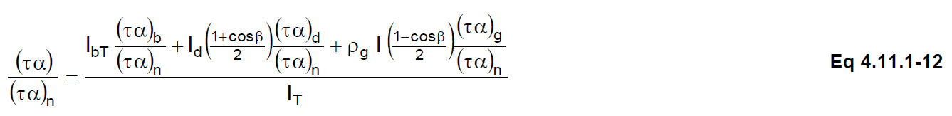
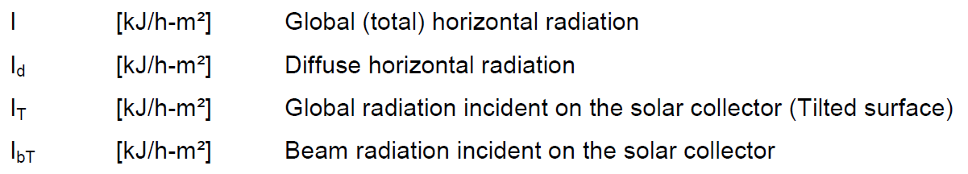
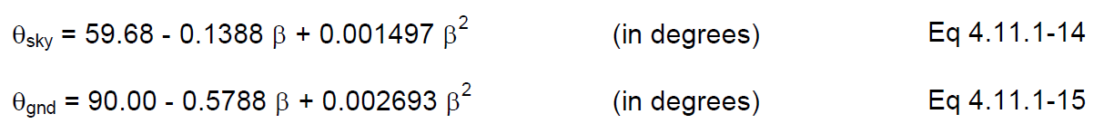
Trnsys Type1: correction non normal solar incidence
τα in test is for normal incidence (τα)n
τα for non-normal solar incidence should be used => a0 * (τα)/(τα)n
(τα)b/(τα)n = IAM for beam radiation
from tests,
supplied versus angle of incidence θ on collector
for tube collector different IAM for longitudinal and transversal direction
flat plate collector is assumed to be symmetrical (one direction is enough)
total IAM is product of IAM’s for different directions
(τα)d/(τα)n = IAM for diffuse radiation (sky diffuse, ground diffuse)
Determined based on equivalent incidence angle
Sky diffuse radiation on tilted surface
as a fraction of sky diffuse radiation on horizontal ok
Ground reflected radiation on tilted surface
as a fraction of beam + sky diffuse radiation on horizontal ok

Slide 8
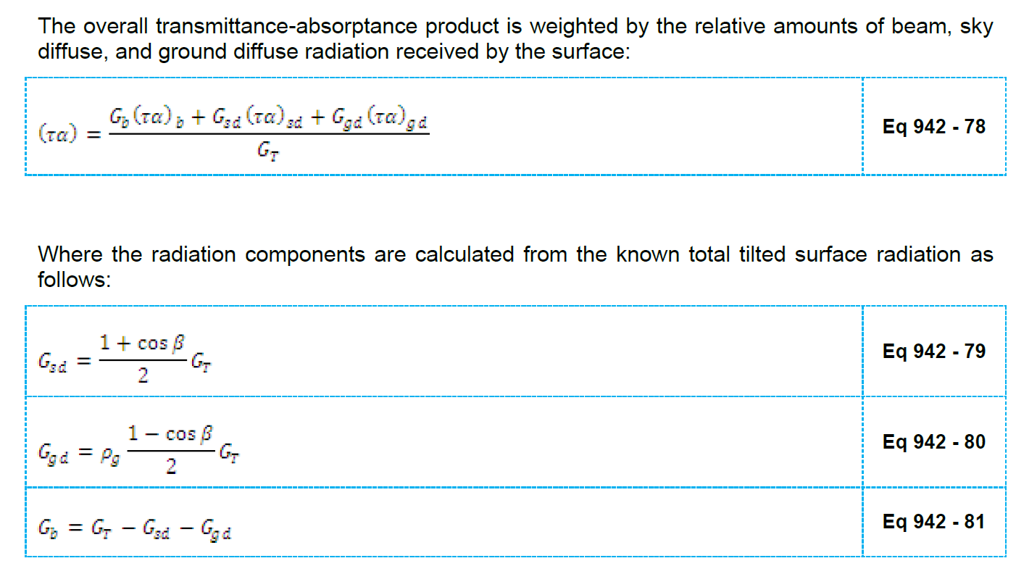
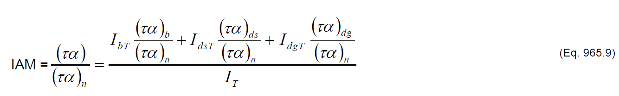
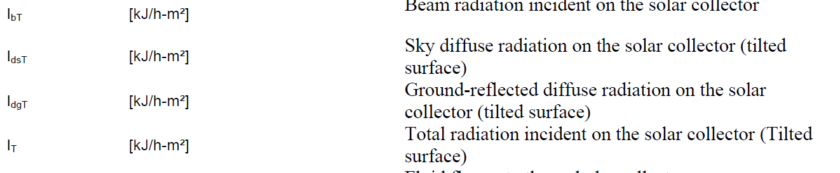
(τα)/(τα)n?
According to Type942 and type 965 resp.:
Should be diffuse radiation on horiz …

Slide 9
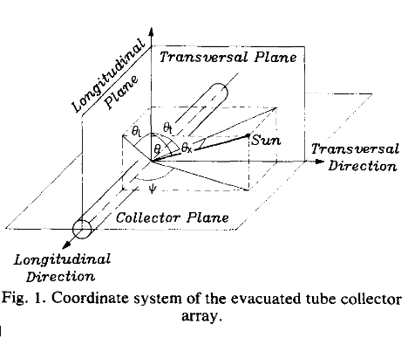
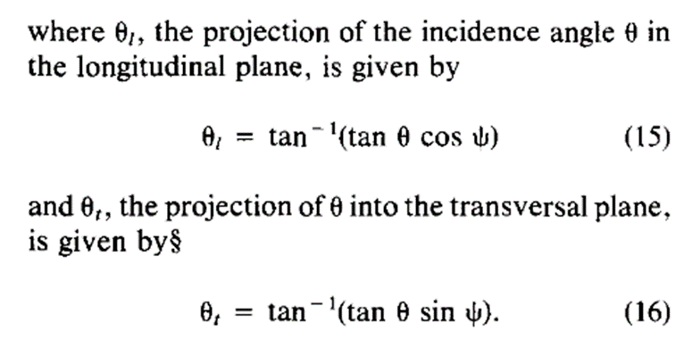
Incident angle in longitudinal and transversal direction
Cf Solar transmittance characteristics of evacuated tubular collectors with diffuse black collectors. P.-H. Theunissen, W.A. Beckman

Slide 10
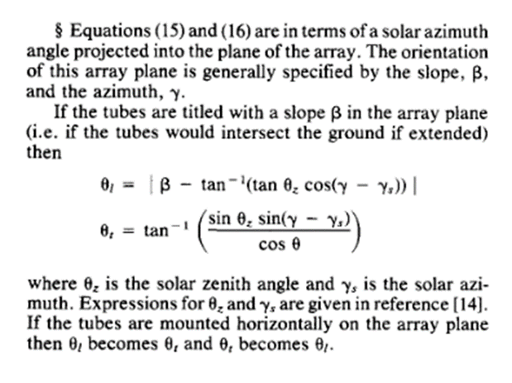
Incident angle in longitudinal and transversal direction
Cf Solar transmittance characteristics of evacuated tubular collectors with diffuse black collectors. P.-H. Theunissen, W.A. Beckman
But, in (15) and (16) Ψ is the angle between collector and sollar azimuth in the collector plane, so for non-horizontal collector with slope β:

Slide 11
comparison matlab model with trnsys Type1 and 71
!!! Coefficients a1,a2 in eff=a0-a1*deltaT/It – a2*deltaT²/It are given in W/m²K or W/m²K² !! (so correction needed for trnsys kJ/h)
!! This simplified model doesn’t consider cooling/heating of collector itself (for instance cooling during night)/in TRNSYS collector fluid is cooling down if there is no solar radiation…
Seems like It is important, inc angle and IAM not that much …

Slide 12
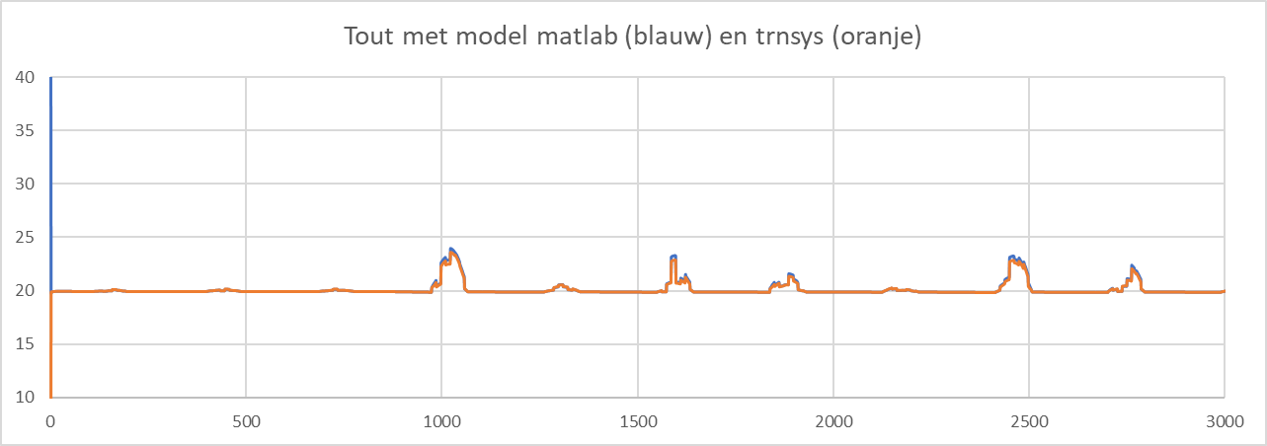
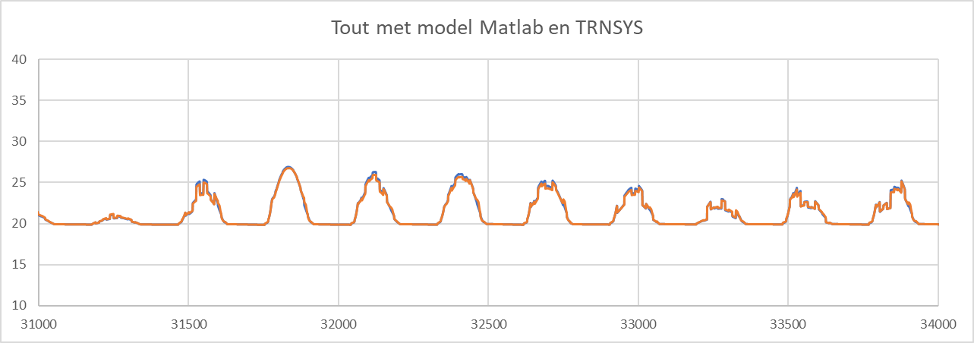
comparison matlab model with trnsys Type1 and 71

Slide 13
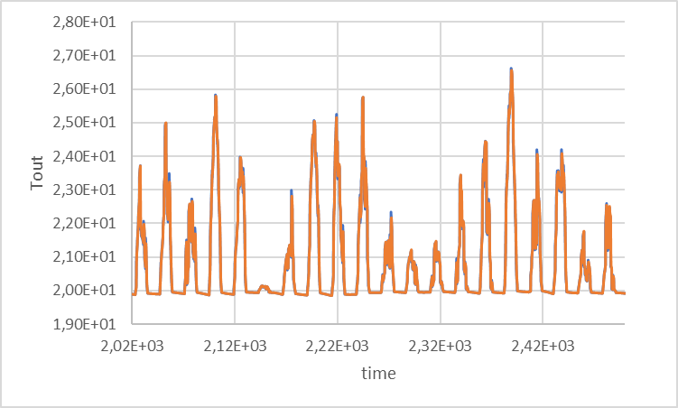
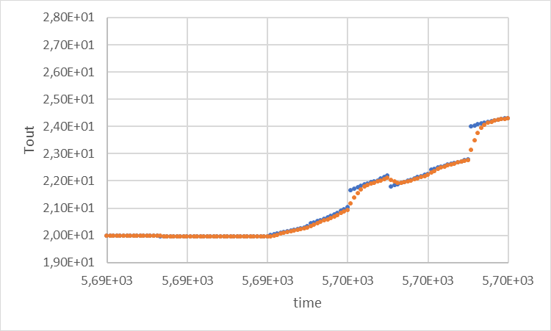
Consider capacitance of collector (TRNSYS)?
TRNSYS model Type71 and 538 are similar models for evacuated tube solar collector, both with quadratic efficiency curve and bi-axial incidence angle modifiers, but only in Type538 the capacitance of the collector may be accounted for.
Results for the same (single) collector:

Slide 14
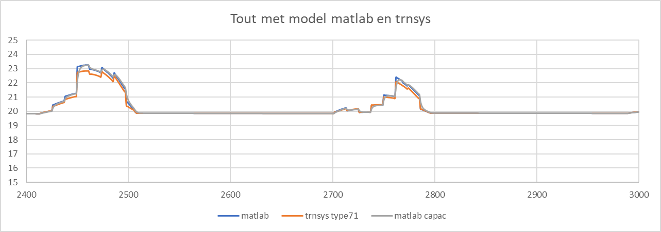
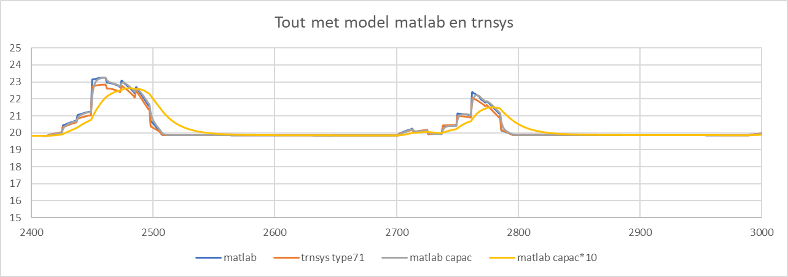
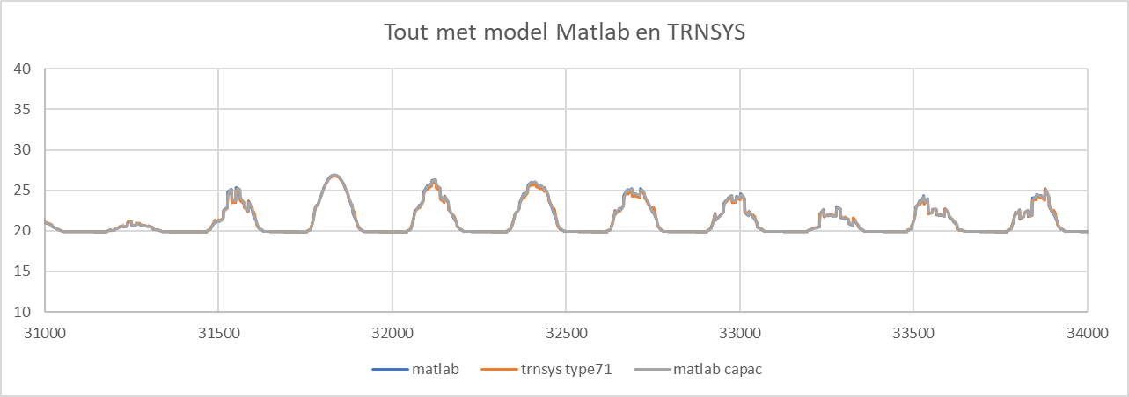
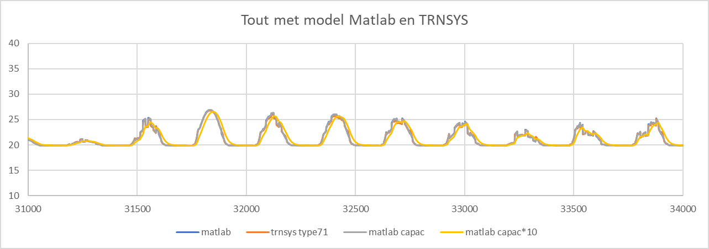
capacitance of collector (Matlab)?
Results for the same (single) collector, flow=testflow: collector capacitance *10, flow=testflow:

Slide 15
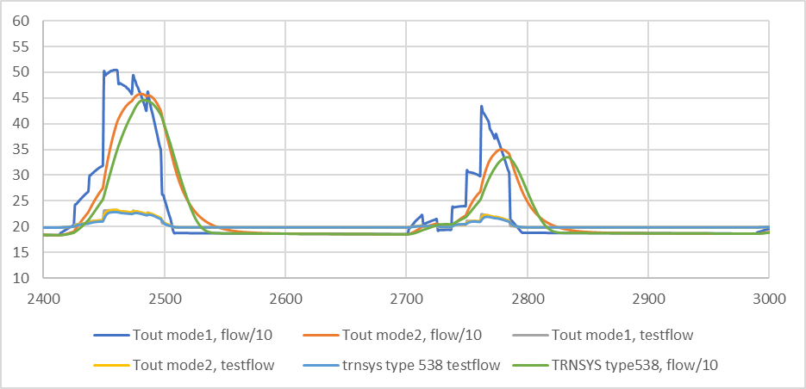
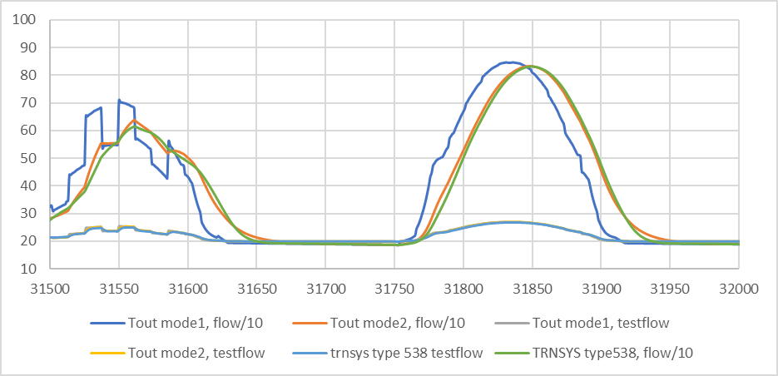
capacitance of collector (Matlab)? Is it problem to work with FR instead of F’ -> impact for different flows (cf F’’ depends on flow)
Results for the same (single) collector, flow=testflow/10:

Slide 16
Better to use model with capacitance, for control, cf if no capacitance Tout has no meaning if flow=0 (no increase of collector temp)

Slide 17
??
Model with capacitance should be with F’ instead of FR, but this wil cause extra loops in calculation and not bring in much…
Collectors in series: correction of FR is possible (or run model for 1 collector multiple times?)
Control? (flow rate constant?)
Serie or parallel?

